Slide 1
Top Employer Workforce challenges 2022
IBA 10th Biennial Global Business Immigration Conference - London 2022
KARAS IMMIGRATION LAW
Professional Corporation

Slide 2
Key employer concerns
Lack of Talent
Costs
Flexibility With People Refusing to Work in Person
Employee Performance While Working From Home
Overregulation
Housing Affordability
KARAS IMMIGRATION LAW
Professional Corporation

Slide 3
Lack of talent
Nearly one million job openings across Canada
In the fourth quarter of 2021, 915,500 positions remained unfilled
Job vacancies remain unfilled for more than 60 days
Indeed job postings up 69% as of March 18, 2022
Top 10 Occupation Vacancies
1. Food Counter Attendants and Kitchen Helpers 2. Retail Salespersons
3. Food and Beverages Servers 4. Registered Nurses and Registered Psychiatric Nurses
5. Cooks 6. Construction Trades
7. Helpers and Labourers 8. Nurse aids, Orderlies and Patient Associates
9. Light Duty Cleaners 10. Store Shelf Stockers, Clerks and Order Fillers
CBC - https://www.cbc.ca/news/business/job-skills-shortage-1.6409237
Statistics Canada - https://www150.statcan.gc.ca/n1/daily-quotidien/220322/t001a-eng.htm
KARAS IMMIGRATION LAW
Professional Corporation

Slide 4
Costs
Conference Board of Canada Report – Skills shortage cost the Canadian economy billions of dollars and estimated the unrealized value of skills vacancies was $25 billion in 2020
Inflation
CPI increased 7% as the Bank of Canada continues to raise interest rates.
Businesses struggling with costs and having to transfer employees from other countries increase costs.
Canadian Chamber of Commerce Chief Economist Stephen Tapp: “Running a business right now, it’s extremely expensive and it’s hard to do given the lack of access to workers and input costs rising pretty considerably.”
Yahoo - https://www.yahoo.com/now/inflation-tops-list-concerns-canadian-100011597.html
CBC - https://www.cbc.ca/news/business/job-skills-shortage-1.6409237
KARAS IMMIGRATION LAW
Professional Corporation

Slide 5
EMPLOYEES refusing to RETURN TO THE OFFICE
Banks now requiring employees to return to the office at least three days a week
Over 80% of teleworkers indicated that they would like to work at least half of their hours from home.
41% would prefer working about half of their hours at home and the other half elsewhere while 39% preferred working most (24%) or all (15%) of their hours at home.
The remaining 20% would prefer working most (11%) or all (9%) of their hours outside the home.
RBC asking employees to come to the office
CEO: “technology cannot replicate the energy, spontaneity, big ideas, true sense of belonging and fun” of being together in person
Statistics Canada - https://www150.statcan.gc.ca/n1/pub/45-28-0001/2021001/article/00012-eng.htm
Bloomerg - https://www.bloomberg.com/news/articles/2022-08-16/royal-bank-of-canada-asking-employees-to-come-to-the-office-more
KARAS IMMIGRATION LAW
Professional Corporation

Slide 6
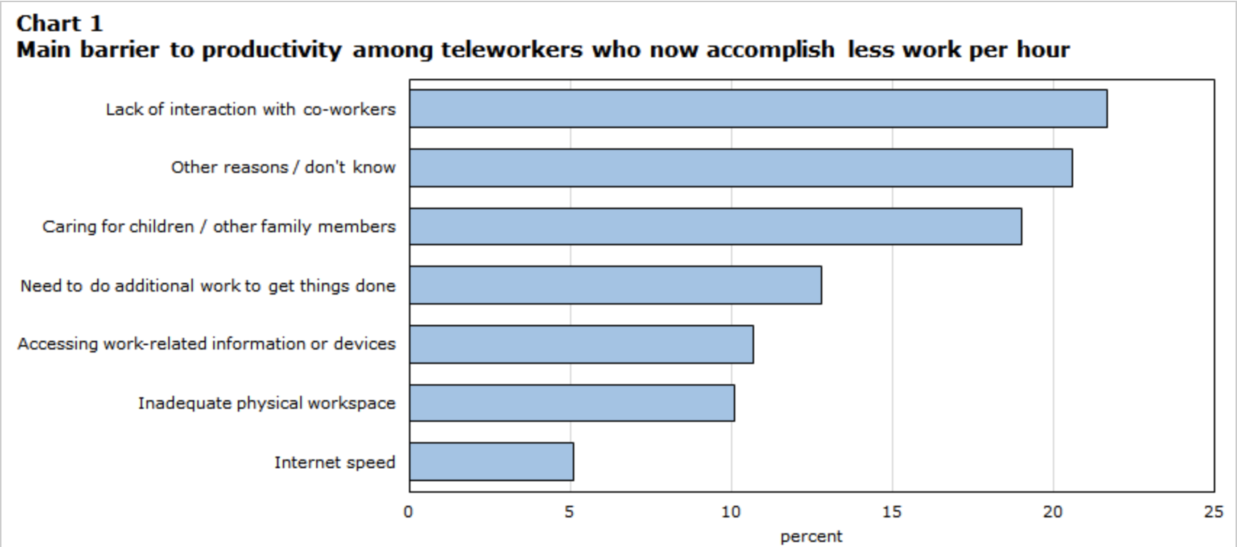
Employee Performance while working from home
Lack of interaction with co-workers as the main reasons (22%)
Other reasons that are unknown (21%)
Having to care for children or other family members (20%)
Need to do additional work to get things done 13%)
Accessing work related information or devices (11%)
Inadequate physical workspace (10%)
Having trouble with internet speed (5%)
Statistics Canada - https://www150.statcan.gc.ca/n1/pub/45-28-0001/2021001/article/00012-eng.htm
KARAS IMMIGRATION LAW
Professional Corporation

Slide 7
Overregulation
New employer obligations by IRCC meant to protect temporary foreign workers.
New regulations apply to the Temporary Foreign Worker Program (TFWP) (LMIA) and the International Mobility Program (IMP)
Obligations include:
Providing TFWs with information regarding their rights in Canada
Providing an employment agreement to the TFW
No longer charging or recovering fees from employees
Protecting the health and safety of TFWs
Government of Canada – Employment and Social Development Canada - https://www.canada.ca/en/employment-social-development/news/2022/09/new-amendments-to-the-immigration-and-refugee-protection-regulations-temporary-foreign-workers.html
KARAS IMMIGRATION LAW
Professional Corporation

Slide 8
Housing Affordability
Angus Reid Institute and Publicis Media survey of 500 newcomers showed that almost half intended to leave Canada or considered leaving due to high cost of living and housing market .
Financial Post - https://financialpost.com/news/economy/victor-dodig-canada-immigration-housing-affordability
KARAS IMMIGRATION LAW
Professional Corporation

Slide 9
Thank you for joining us
Sergio R. Karas, B.A., J.D. Certified Specialist in Citizenship and Immigration Law By the Law Society of Ontario Co-Chair American Bar Association Immigration and Naturalization Committee Section of International Law Past Chair Ontario Bar Association Citizenship and Immigration Section Past Chair International Bar Association Immigration and Nationality Committee KARAS IMMIGRATION LAW PROFESSIONAL CORPORATION Barristers and Solicitors- Immigration Lawyers- 65 Queen Street West, Suite 1505 - Box 35 - Toronto, Ontario, CANADA M5H 2M5 Tel: (416) 506-1800 - Fax: (416) 506-1305 www.karas.ca
KARAS IMMIGRATION LAW
Professional Corporation

